Slide 1
Database Systems
Lecture 21
Functional Dependencies

Slide 2
Today’s Agenda
Informal Design Guidelines for Relational Databases
Semantics of the Relation Attributes
Reducing the Redundant Information in Tuples and Update Anomalies
Reducing the Null Values in Tuples
Disallowing the possibility of generating Spurious Tuples
Functional Dependencies

Slide 3
Informal Design Guidelines for Relational Databases (1)
What is relational database design?
The grouping of attributes to form "good" relation schemas
Two levels of relation schemas
The logical "user view" level
The storage "base relation" level
Design is concerned mainly with base relations
What are the criteria for "good" base relations?

Slide 4
Semantics of the Relation Attributes
GUIDELINE 1: Informally, each tuple in a relation should represent one entity or relationship instance. (Applies to individual relations and their attributes).
Attributes of different entities (EMPLOYEEs, DEPARTMENTs, PROJECTs) should not be mixed in the same relation
Only foreign keys should be used to refer to other entities
Entity and relationship attributes should be kept apart as much as possible.
Bottom Line: Design a schema that can be explained easily relation by relation. The semantics of attributes should be easy to interpret.

Slide 5
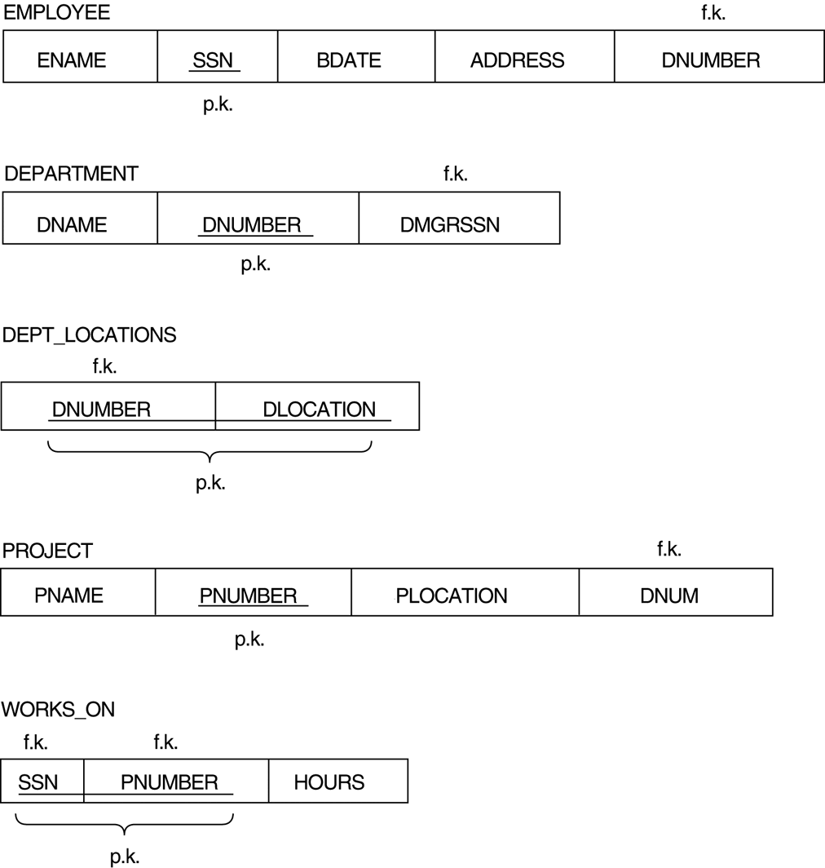
Figure 10.1 A simplified COMPANY relational database schema

Slide 6
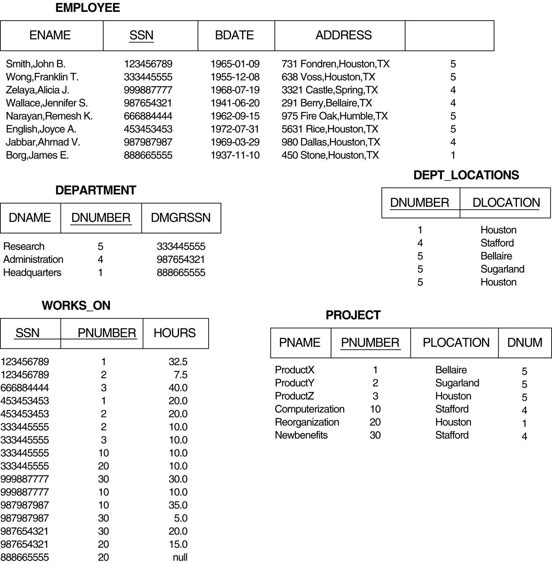
Example database state for the relational database schema of Figure 10.1.

Slide 7
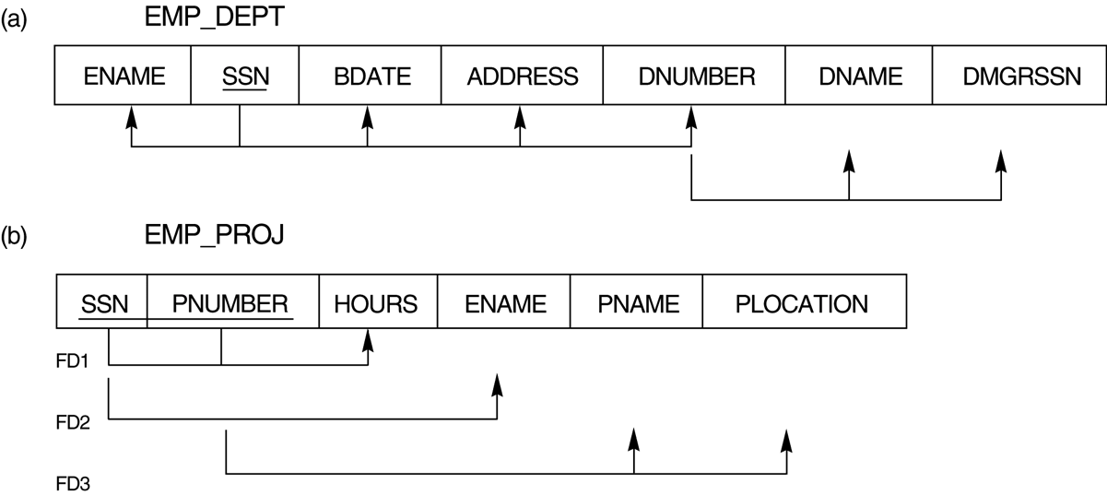

Slide 8
Redundant Information in Tuples and Update Anomalies
Mixing attributes of multiple entities may cause problems
Information is stored redundantly wasting storage
Problems with update anomalies
Insertion anomalies
Deletion anomalies
Modification anomalies

Slide 9
EXAMPLE OF AN UPDATE ANOMALY (1)
Consider the relation:
EMP_PROJ ( Emp#, Proj#, Ename, Pname, No_hours)
Update Anomaly: Changing the name of project number P1 from “Billing” to “Customer-Accounting” may cause this update to be made for all 100 employees working on project P1.

Slide 10
EXAMPLE OF AN UPDATE ANOMALY (2)
Insert Anomaly: Cannot insert a project unless an employee is assigned to .
Inversely - Cannot insert an employee unless he/she is assigned to a project.
Delete Anomaly: When a project is deleted, it will result in deleting all the employees who work on that project. Alternately, if an employee is the sole employee on a project, deleting that employee would result in deleting the corresponding project.

Slide 11
Figure 10.3 Two relation schemas suffering from update anomalies

Slide 12
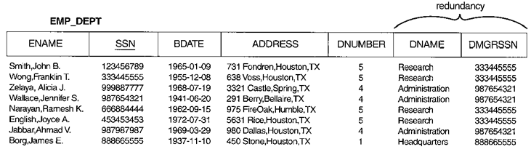
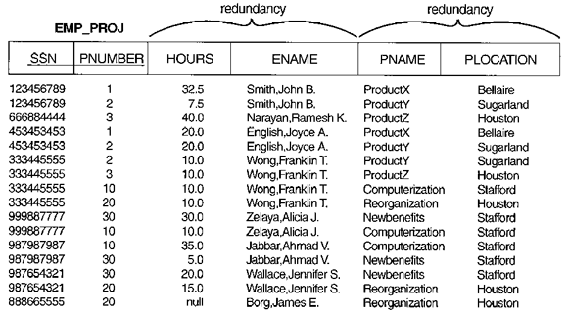
Figure 10.4 Example States for EMP_DEPT and EMP_PROJ
Note: The above figure is now called Figure 10.4 in Edition 4

Slide 13
Guideline to Redundant Information in Tuples and Update Anomalies
GUIDELINE 2: Design a schema that does not suffer from the insertion, deletion and update anomalies. If there are any present, then note them so that applications can be made to take them into account

Slide 14
Null Values in Tuples
GUIDELINE 3: Relations should be designed such that their tuples will have as few NULL values as possible
Attributes that are NULL frequently could be placed in separate relations (with the primary key)
Reasons for nulls:
attribute not applicable or invalid
attribute value unknown (may exist)
value known to exist, but unavailable

Slide 15
Spurious Tuples
Bad designs for a relational database may result in erroneous results for certain JOIN operations
The "lossless join" property is used to guarantee meaningful results for join operations
GUIDELINE 4: The relations should be designed to satisfy the lossless join condition. No spurious tuples should be generated by doing a natural-join of any relations.

Slide 16
Spurious Tuples (2)
There are two important properties of decompositions:
non-additive or losslessness of the corresponding join
preservation of the functional dependencies.
Note that property (a) is extremely important and cannot be sacrificed. Property (b) is less stringent and may be sacrificed.

Slide 18
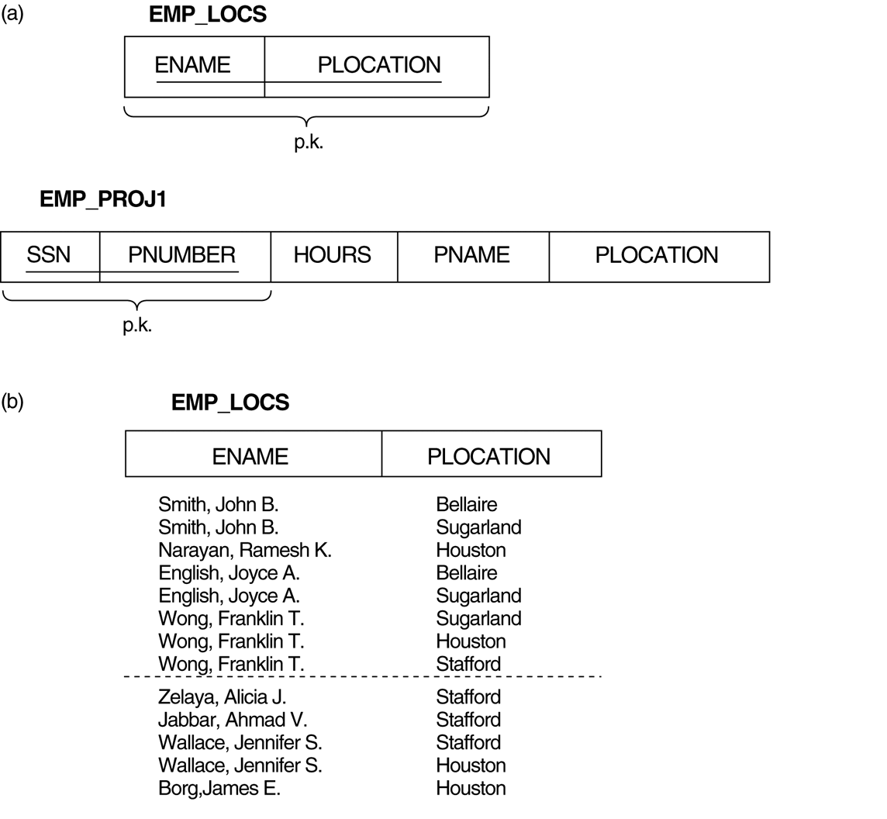
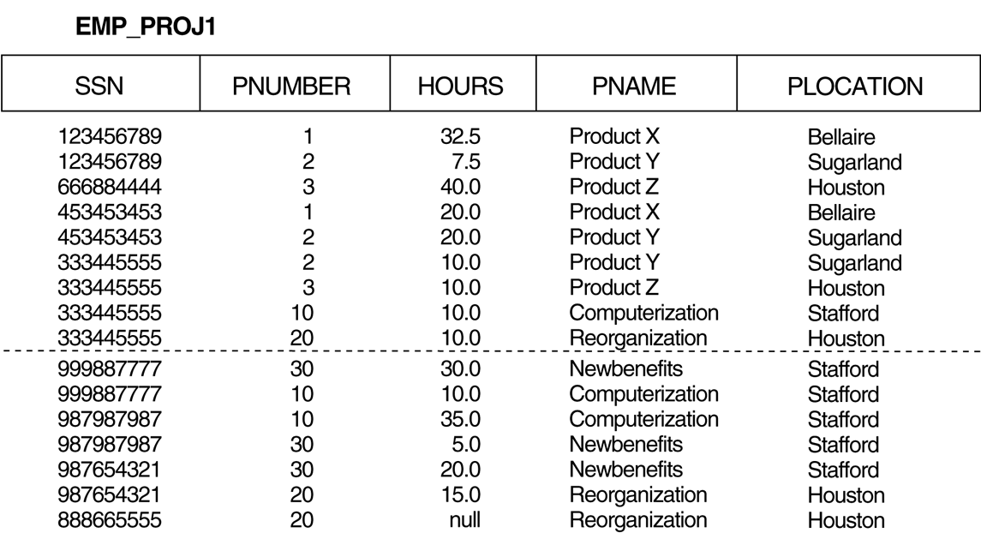
Particularly poor design for the EMP_PROJ relation of Figure 10.3b.

Slide 19
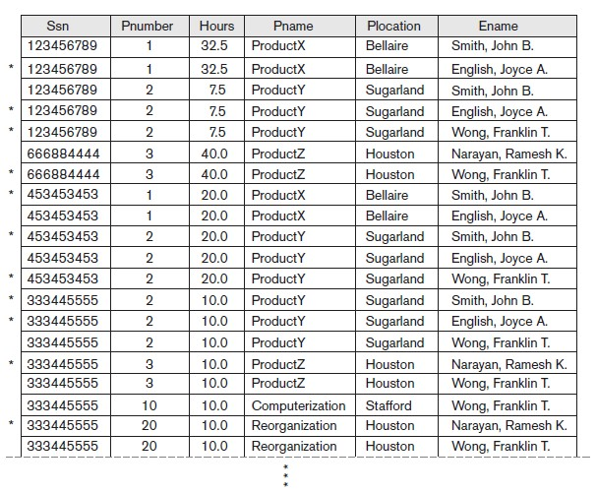
Result of applying NATURAL JOIN to the tuples above the dotted lines in EMP_PROJ1 and EMP_LOCS of Figure 10.5. Generated spurious tuples are marked by asterisks.

Slide 20
Functional Dependencies (1)
Functional dependencies (FDs) are used to specify formal measures of the "goodness" of relational designs
FDs and keys are used to define normal forms for relations
FDs are constraints that are derived from the meaning and interrelationships of the data attributes
A set of attributes X functionally determines a set of attributes Y if the value of X determines a unique value for Y

Slide 21
Functional Dependencies (2)
X -> Y holds if whenever two tuples have the same value for X, they must have the same value for Y
For any two tuples t1 and t2 in any relation instance r(R): If t1[X]=t2[X], then t1[Y]=t2[Y]
X -> Y in R specifies a constraint on all relation instances r(R)
Written as X -> Y; can be displayed graphically on a relation schema as in Figures. ( denoted by the arrow: ).
FDs are derived from the real-world constraints on the attributes

Slide 22
Figure 10.3 Two relation schemas suffering from update anomalies

Slide 23
Examples of FD constraints (1)
social security number determines employee name
SSN -> ENAME
project number determines project name and location
PNUMBER -> {PNAME, PLOCATION}
employee ssn and project number determines the hours per week that the employee works on the project
{SSN, PNUMBER} -> HOURS

Slide 24
Examples of FD constraints (2)
FD is a property of the attributes in the schema R
The constraint must hold on every relation instance r(R)
If K is a key of R, then K functionally determines all attributes in R (since we never have two distinct tuples with t1[K]=t2[K])

Slide 25
Inference Rules for FDs (1)
Given a set of FDs F, we can infer additional FDs that hold whenever the FDs in F hold
Armstrong's inference rules (proposed in 1974):
IR1. (Reflexive) If Y subset-of X, then X -> Y
IR2. (Augmentation) If X -> Y, then XZ -> YZ
(Notation: XZ stands for X U Z)
IR3. (Transitive) If X -> Y and Y -> Z, then X -> Z
IR1, IR2, IR3 form a sound and complete set of inference rules

Slide 26
Inference Rules for FDs (2)
Some additional inference rules that are useful:
(Decomposition) If X -> YZ, then X -> Y and X -> Z
(Union) If X -> Y and X -> Z, then X -> YZ
(Psuedotransitivity) If X -> Y and WY -> Z, then WX -> Z
The last three inference rules, as well as any other inference rules, can be deduced from IR1, IR2, and IR3 (completeness property)

